Slide 1
STA9690 Final Project
Advanced Data Mining
Christopher Lang
December 12, 2017

Slide 2
The Spambase Dataset
A dataset of emails and several key features that describe the content written in the email body
Number of Emails (n) | 2695
Number of Predictors (p) | 57 – 3 = 54 (3 predictors are all zero)
Response | 1512 (~56%) spam 1183 (~44%) non-spam
Sourced Spambase from:
UCI Machine Learning Repository
https://archive.ics.uci.edu/ml/datasets/spambase
Predictor Description
Predictors are broken into three types of measures
Word Frequency % of total words in an email | word_freq_make
 | word_freq_internet
 | word_freq_hp
 | … …
Character Frequency % of total characters in an email | char_freq_semicolon
 | char_freq_exclamation
 | char_freq_dollarsign
 | … …
Capital Run Length The length of a sequence of capital letters | capital_run_length_longest
 | capital_run_length_average
 | capital_run_length_total
 | … …
45 predictors (83%)
6 predictors (11%)
3 predictors (6%)

Slide 3
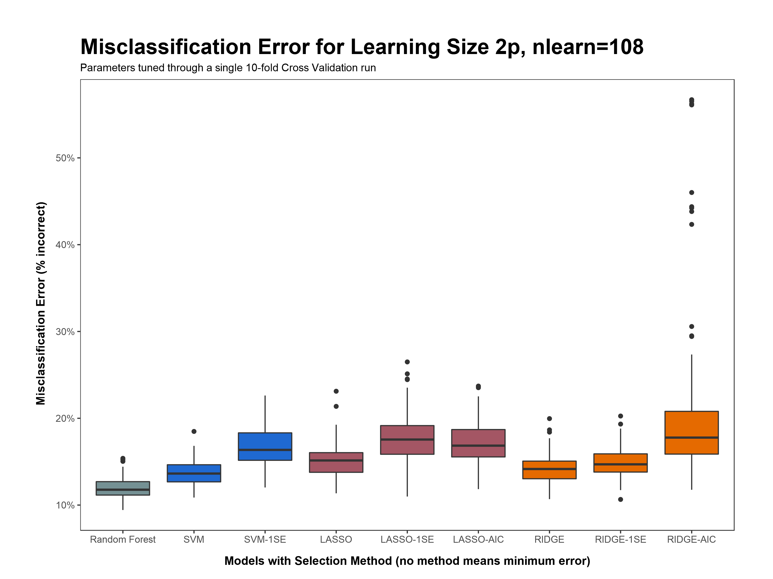
ntree | 500
mtry | 7
replace | TRUE
cost | 10
gamma | 0.006
cost | 100
gamma | 0.010
lambda | 0.04041
lambda | 0.1111
lambda | 0.000004
lambda | 0.2020
lambda | 0.9596
lambda | 0.000004

Slide 4
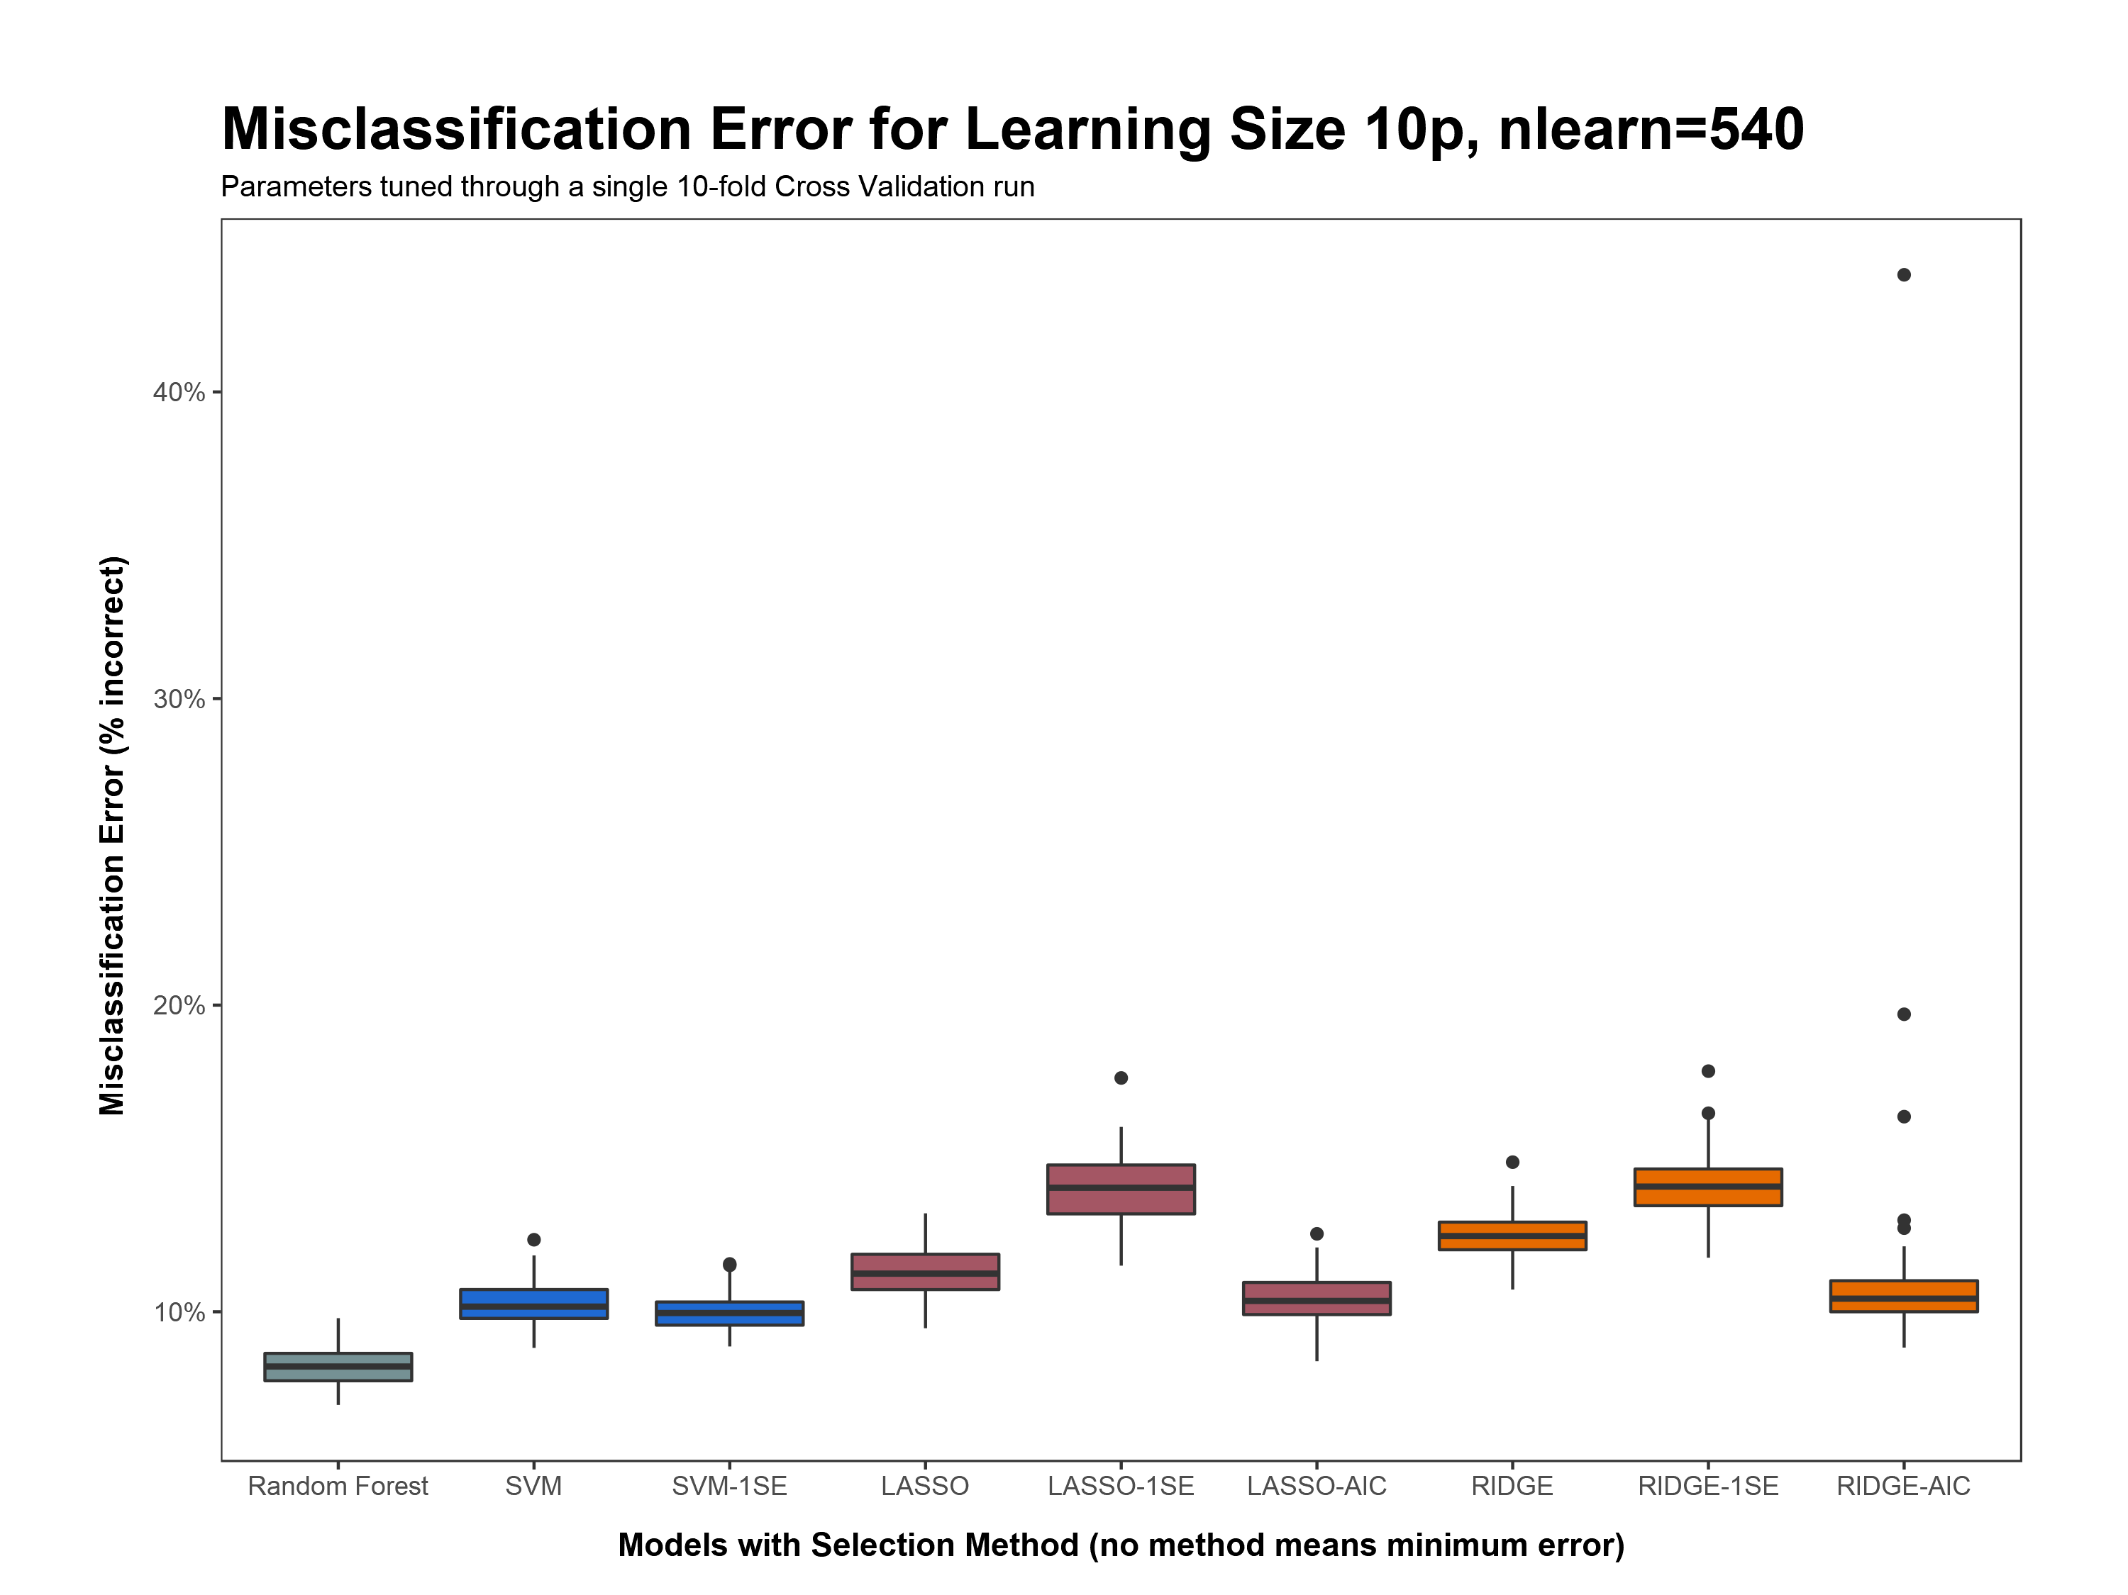
ntree | 1000
mtry | 8
replace | FALSE
cost | 200
gamma | 0.002
cost | 10
gamma | 0.007
lambda | 0.0101
lambda | 0.0505
lambda | 0.000004
lambda | 0.3131
lambda | 1.0
lambda | 0.000004

Slide 5
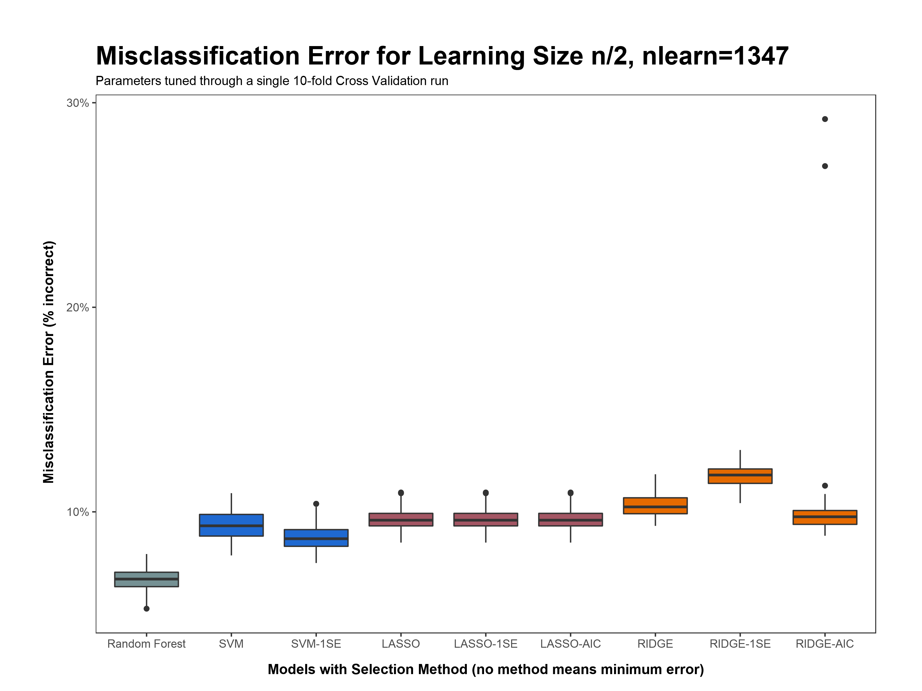
ntree | 500
mtry | 9
replace | FALSE
cost | 100
gamma | 0.008
cost | 10
gamma | 0.008
lambda | 0.000004
lambda | 0.000004
lambda | 0.000004
lambda | 0.0101
lambda | 0.1616
lambda | 0.000004

Slide 6
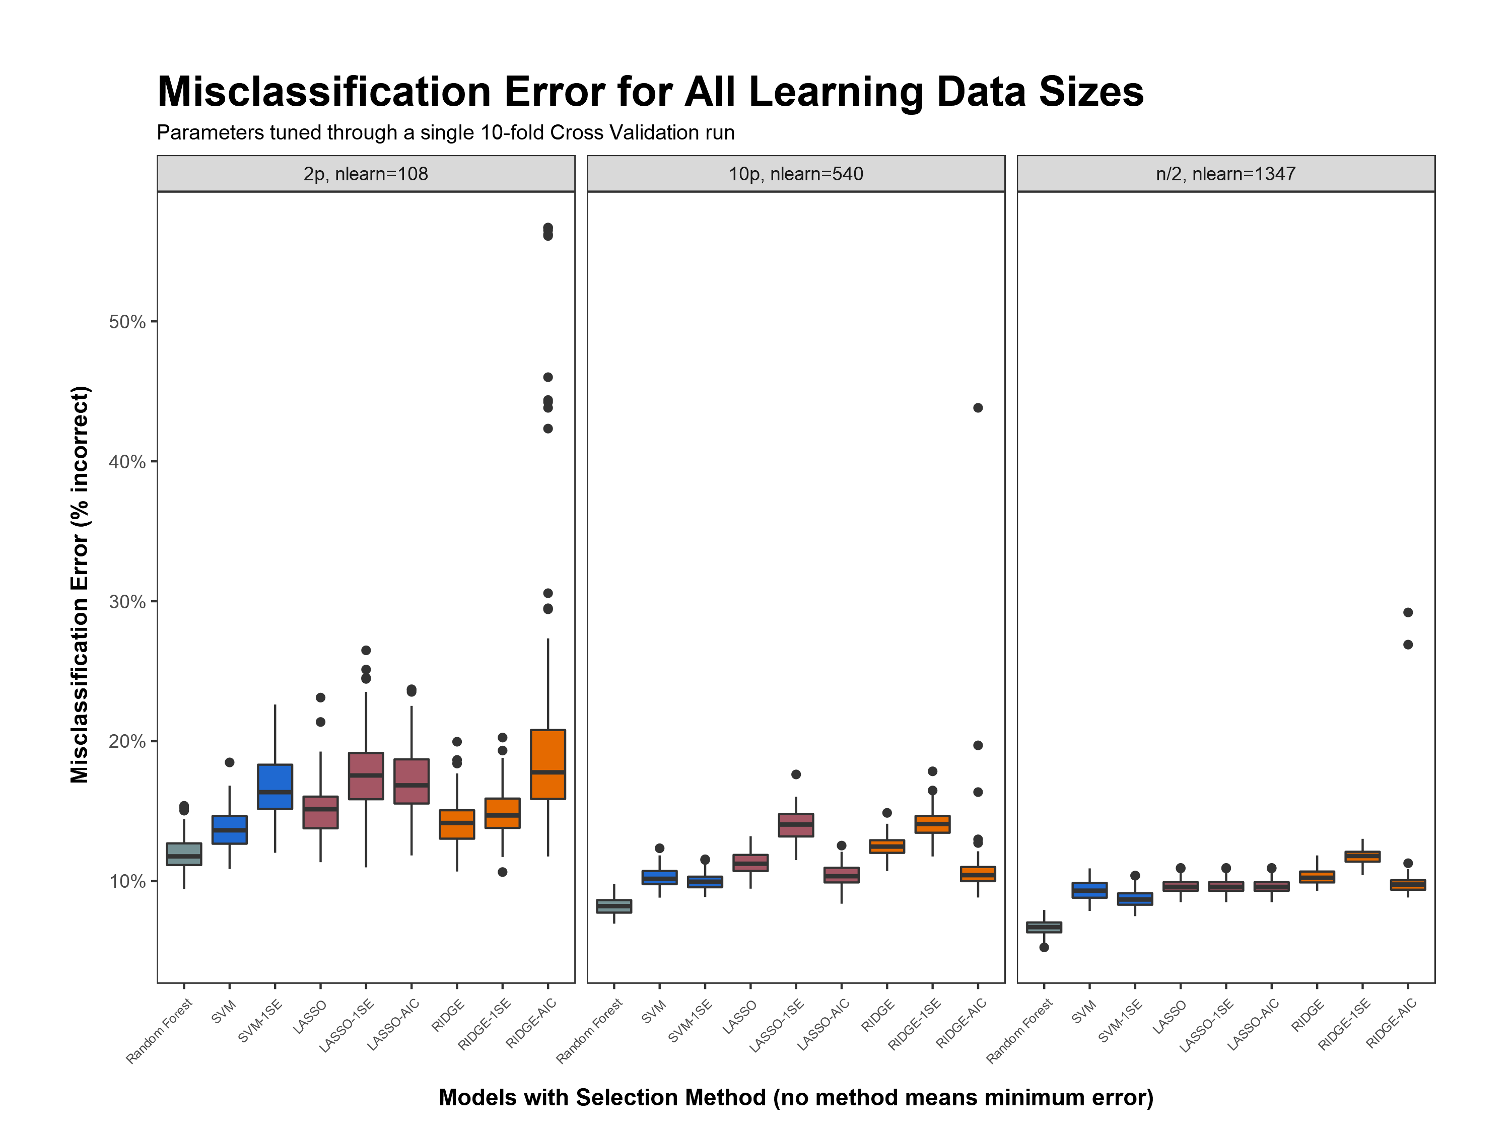

Slide 7
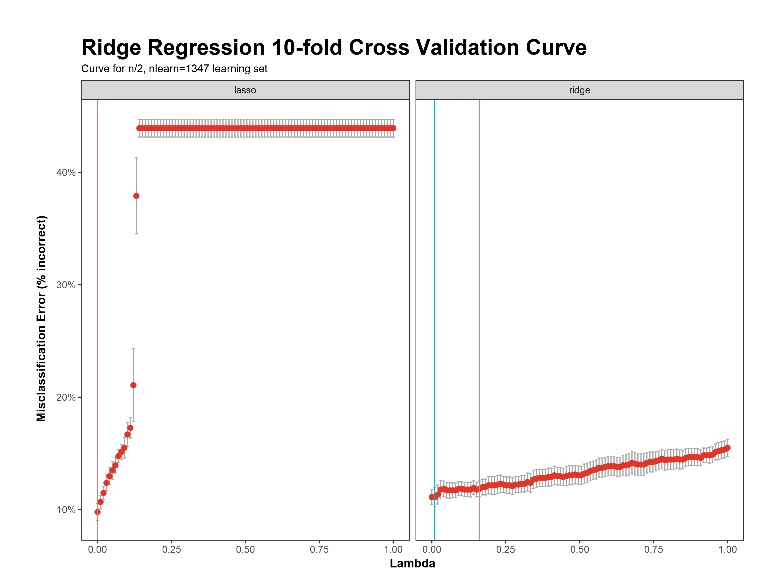
Lambda (1SE Rule): 0.1616
Lambda (min error): 0.0101
Lambda (min error): 0.000004
Lambda (1SE Rule): 0.000004

Slide 8
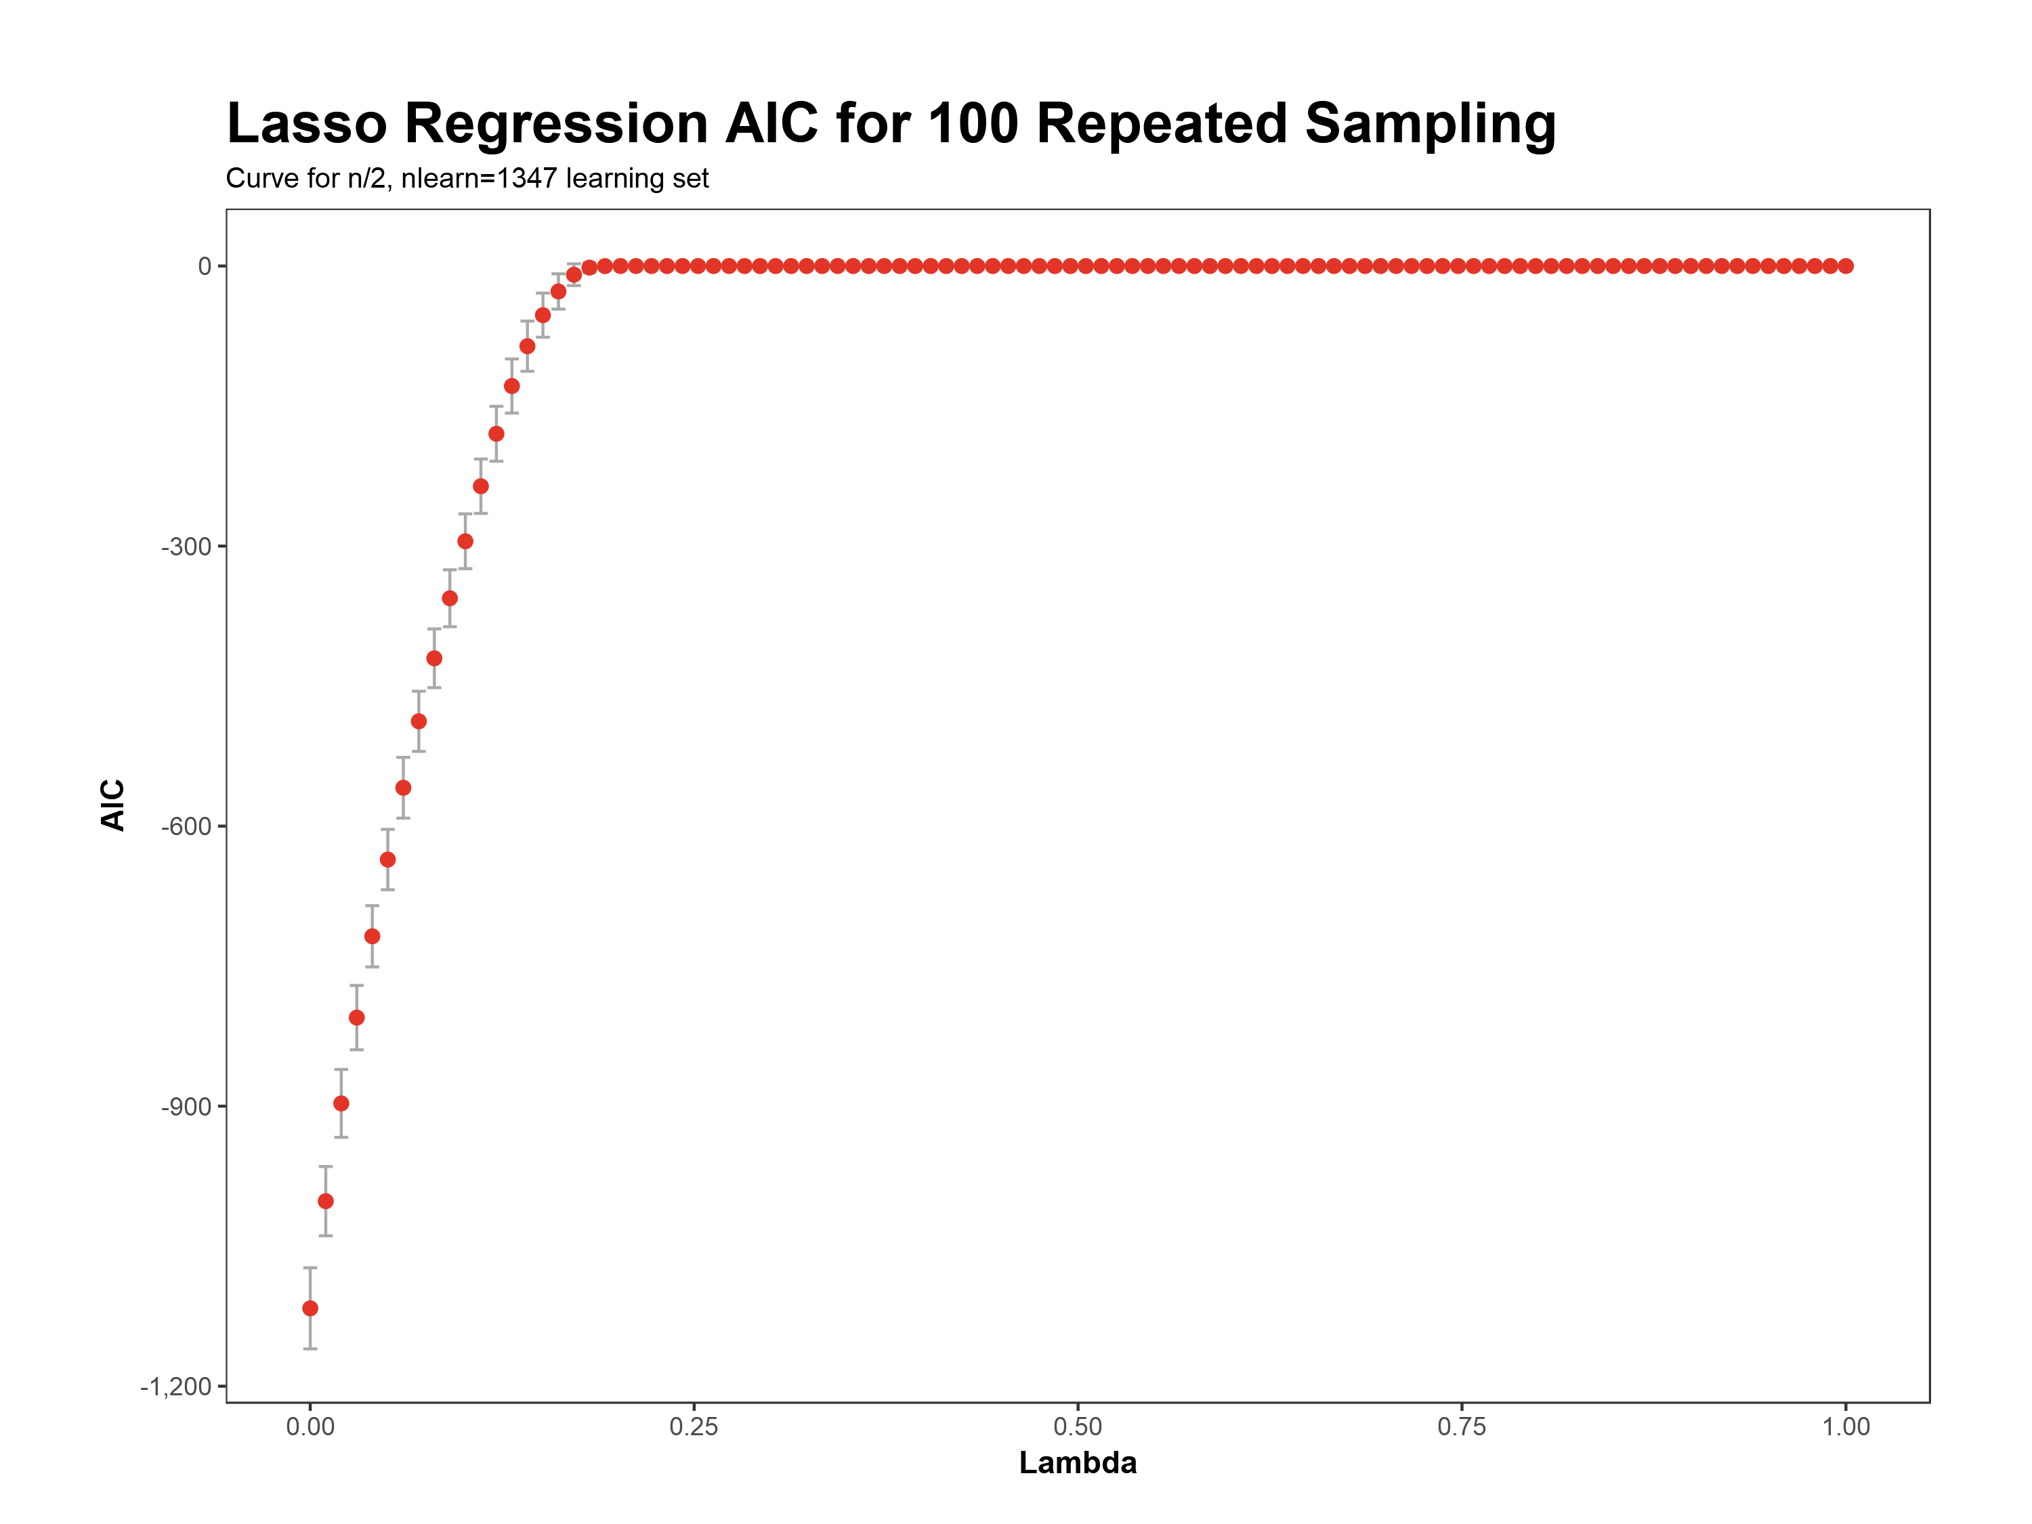

Slide 9
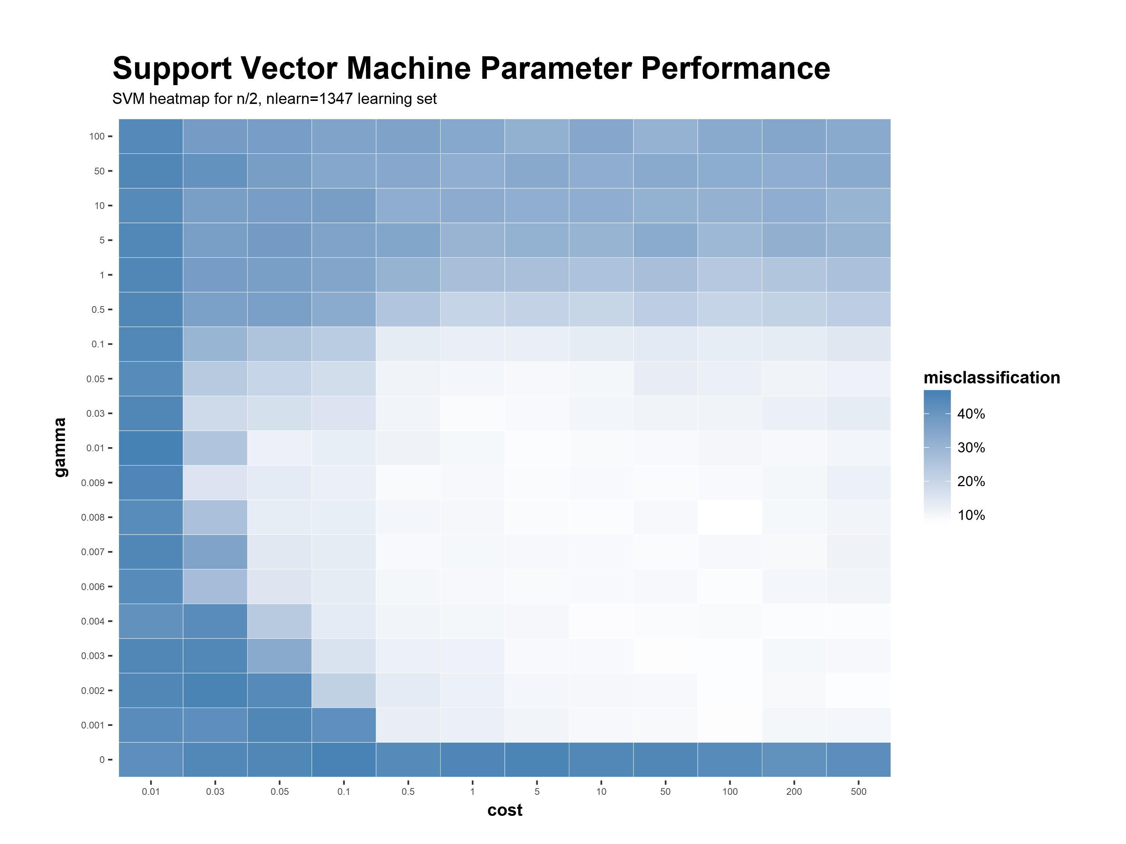

Slide 10
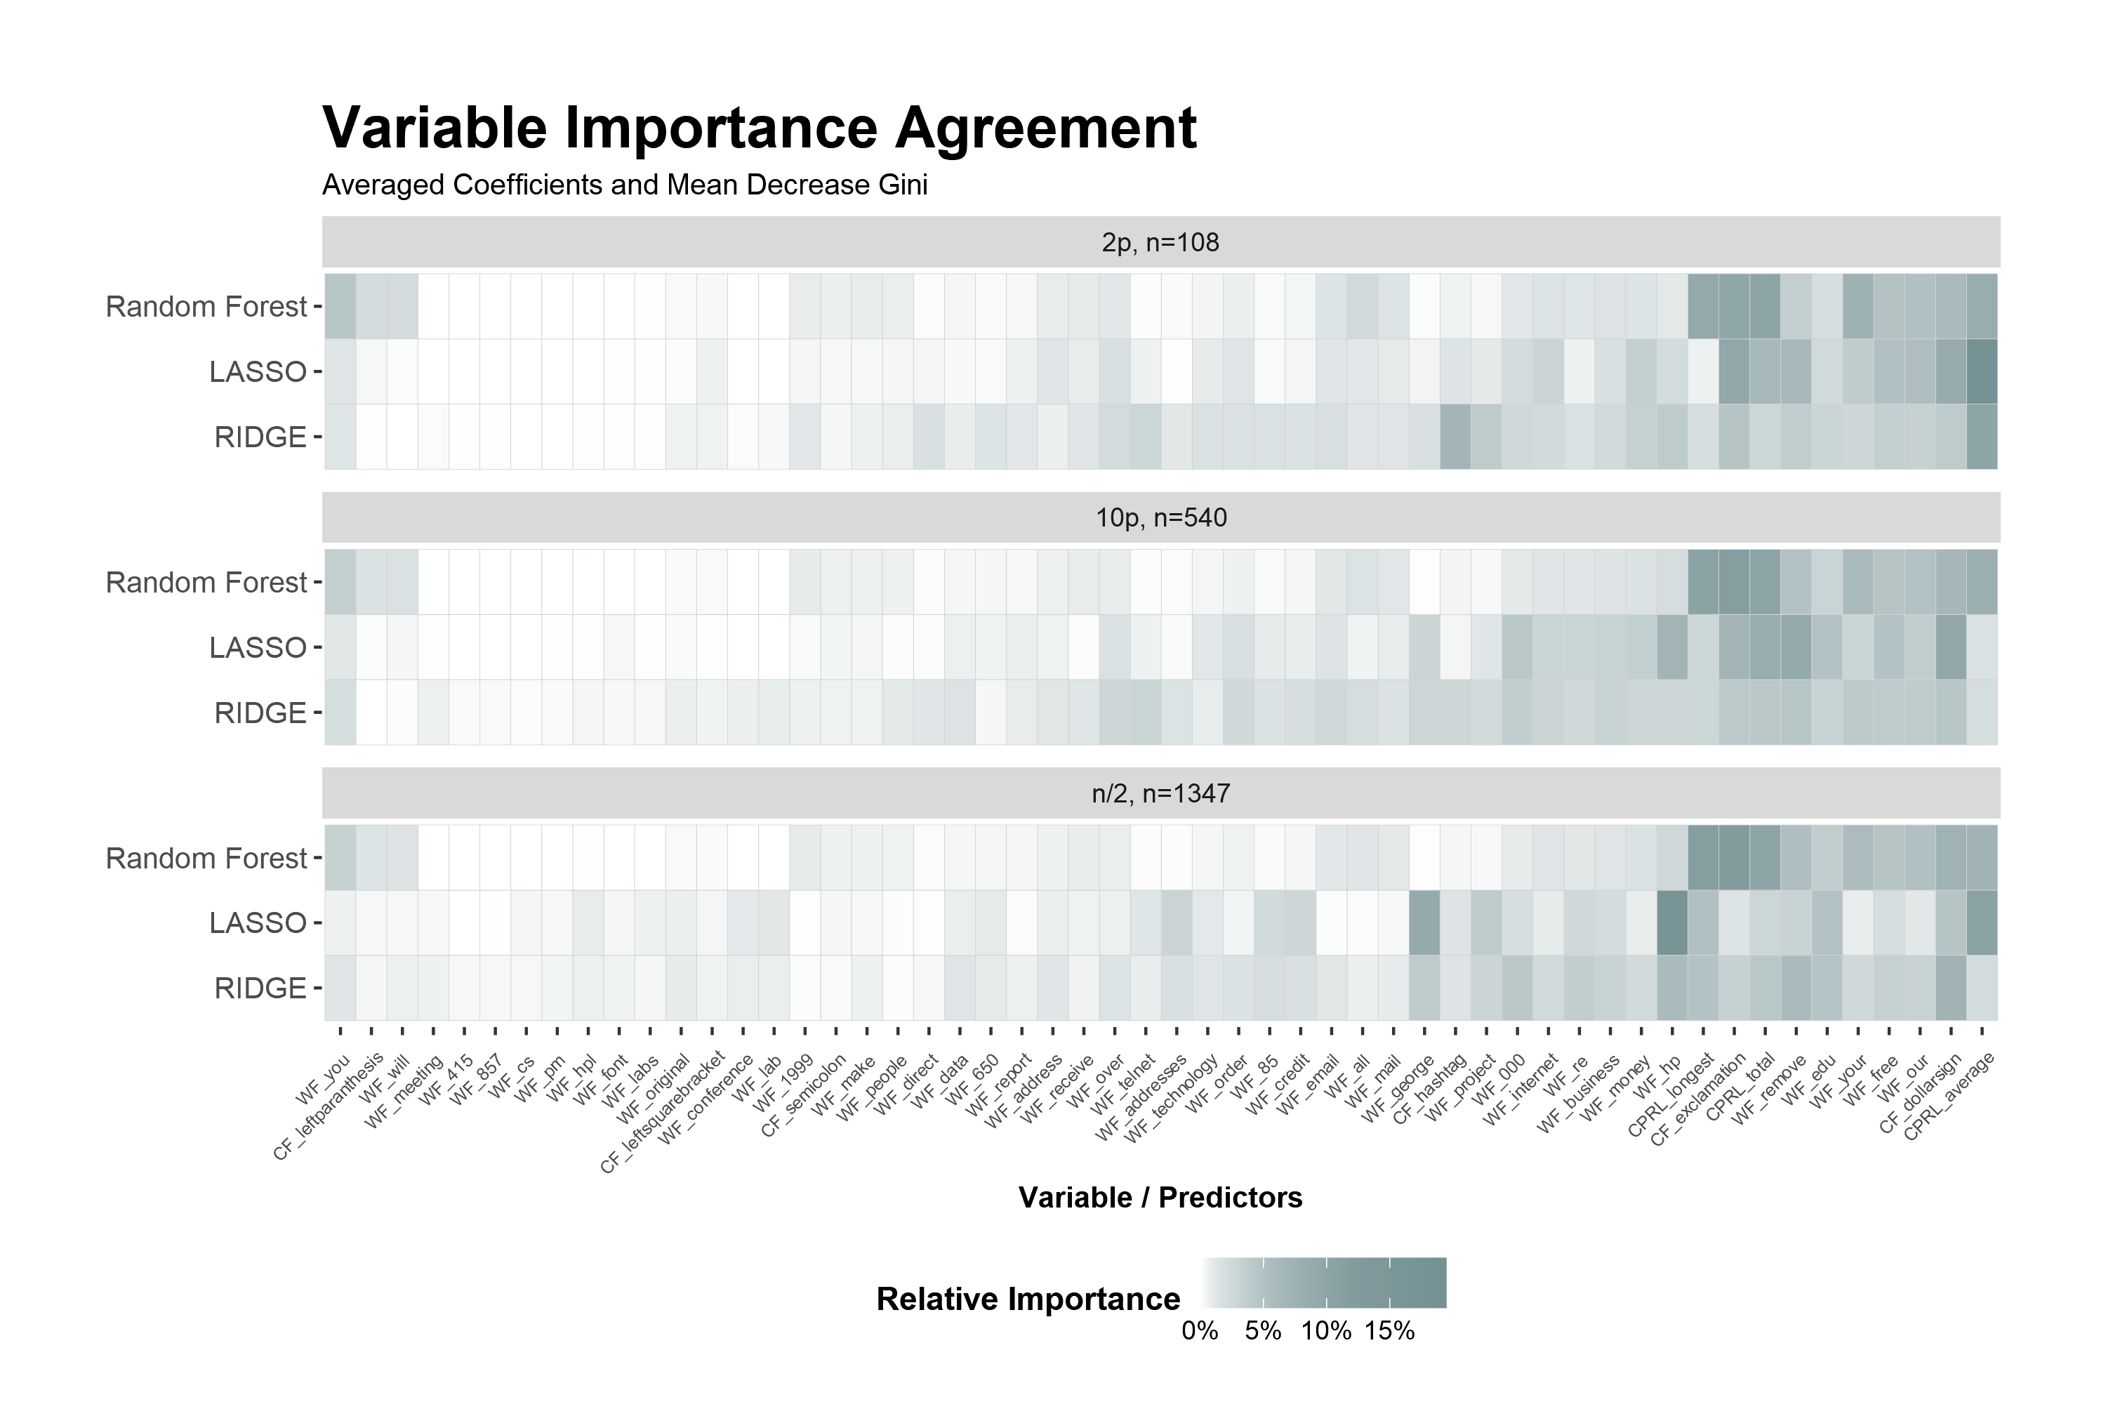
Model
Variable Naming Scheme
<variable type>_<word/character/measure>
WF – Word Frequency (% of total words in an email)
CF – Character Frequency (% of total characters in an email)
CPRL – Capital Run Length (The length of a sequence of capital letters)

